Slide 1

Project 2 Proposal
Vedi Patel, Kritika Saini,
Craig Stebbing, Aman Todi

Slide 2

GE Wind Turbine
Opportunity to gain hands on experience with a real-world problem
Diverse engineering backgrounds: mechanical, electrical, computer engineering, data science
Promote clean energy solutions and feel motivated to choose this project.
Confidence in the team's individual skills and collaborative ability

Slide 3
Skills
Kritika-
Intended Computational Data Science Major
Vedi-
Mechanical Engineering Major
Strong background in Math, Physics, Chemistry, and Biology
Experience with AutoCAD
Strong background in Math and Physics
Experienced with Javascript, PHP, MYSQL, Python and R

Slide 4
Skills Cont.
Aman-
Computer Engineering major
Experienced in Java, Python; working on Inventor with MSU SRT
Craig-
Electrical Engineering major.
Strong history in math and science subjects.
Understanding of programing languages
Previous history involving working with electronics.
Strong subjects – Physics and Mathematics
Previous experience with analyzing Big Data

Slide 5
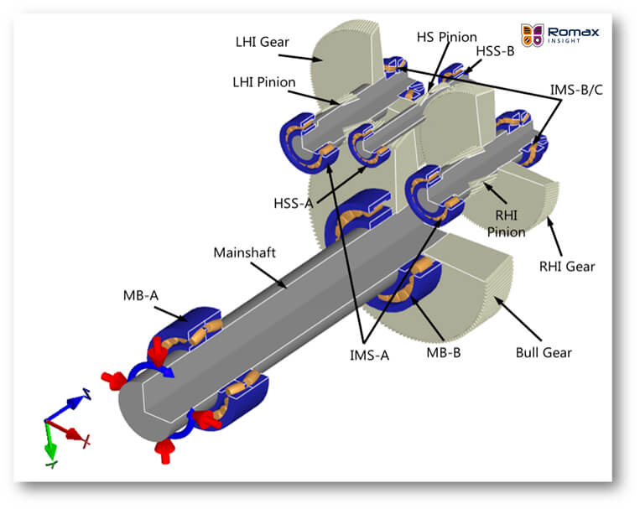
Brainstorm Ideas
Research
Understand the detailed design of a WTG gearbox
Possible Solutions
Redesigning gearbox
Compare its design to other industrial gearboxes to see what makes it an “open air” application
Access what parts are most affected by water ingress
Changing the orientation of parts within the gearbox
Using absorbents, drier
Heating

Slide 6
Timeline
Oct 23
Attend meeting with GE reps (latest 10/30)
Research
Brainstorm Ideas
Communicate with group
Nov 30
Final report and poster due
Narrow down ideas
Nov 10
Nov 1
Finish prototype/ Model and calculations
Initiate design
Nov 20
Compile Final Design
Work on Draft poster
Initiate testing
Start working on final report and presentation
Presentation

Slide 7
Other Preferences
BorgWarner Hydrogen Fuel Cell
Water Filtration Design

